Slide 1
Safeguarding drunk new York city
Merrymel george

Slide 2
Introduction
New York -12th largest city with around 9 million population
91% of New Yorkers consume alcohol , 78% does barhopping, take drugs during weekdays
Crime caused under alcohol/drug influence is alarmingly high
NYPD has to monitor the entire New York, especially pubs/bars/nightclubs to curb/reduce the crime rate

Slide 3
problem
Around 600 pubs/bars/nightclubs in New York – NYPD needs to patrol the entire 600 of them continuously.
Solution – setting up Outposts for groups of bars/pubs/nightclubs
Outposts of a group should equidistant from the bars/pubs/nightclubs of that group for efficient deployment of backup force as well as patrolling
The location of the Outposts must be dynamic based on closing or opening of bars/pubs/nightclubs to increase the efficiency of patrolling and to decrease the usage of resources

Slide 4
Data acquisition and cleansing
New York data : Boroughs, neighborhoods, latitude and longitude - https://cocl.us/new_york_dataset
Pub/bar/nightclub data – Foursquare API
Normalize the Foursquare API data, drop the bad records (records with NULL value for Latitude, Longitude, Name attributes) , drop the duplicates for the combination of Latitude, Longitude, Name attributes
Foursquare API – 647 records pulled , After data cleansing – 564 records

Slide 5
Data analysis methodology
Clustering – Euclidean distance based, non equal sized cluster
KMeans algorithm
Centroid of clusters as the Outpost location
Number of Outpost planned = 25 (randomly chosen number)

Slide 6
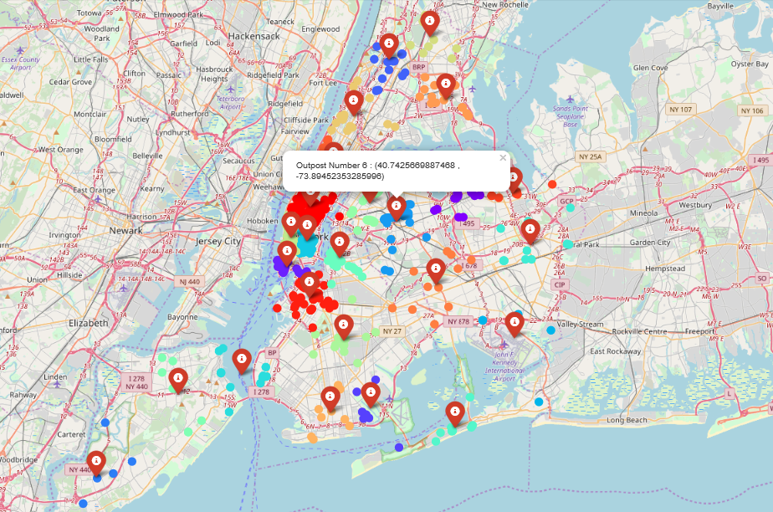
result

Slide 7
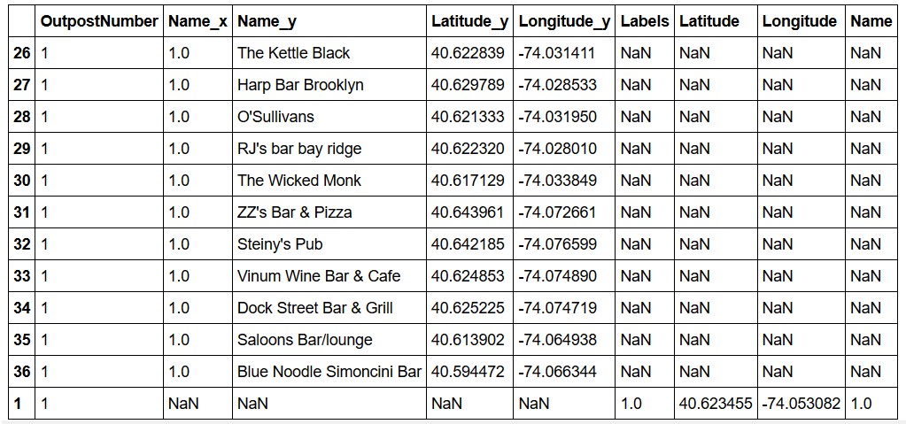
Result contd
The records with the NaN values for Name_x, Name_y, Latitude_y and Latitude_y corresponds to the Outpost location, while all the other records corresponds to bars/pubs/nightclubs which are under that Outpost

Slide 8
Discussion and conclusion
Unequal cluster size – NYPD needs to allocate enough police cars to Outposts depending on the number of bars/pubs under each Outpost
This method can help NYPD patrol New York bars/pubs/nightclubs effectively, efficiently and continuously.
Each bar/pub – equidistant from cluster Outpost – efficient deployment of backup force and patrolling
Better safeguarding of New York city

